Slide 1

RDSH in Amazon AWS
BriForum 2016
160721

Slide 2

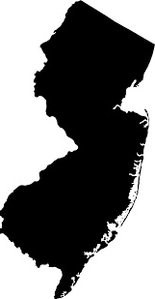

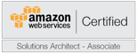
Your Speakers
James Lui
Head of Product Management at Ericom Software
Based in Closter, New Jersey
AWS Certified
Erez Pasternak
Head of Innovation at Ericom Software
Based in Jerusalem, Israel
Leads DevOps in Cloud for Ericom Software

Slide 3
The Agenda:
Cloud Basics
Some Nerdy AWS Work
Even Nerdier RDS Stuff
Show Off Some Automation
Recap Lessons Learned
Credits and Links to all Resources

Slide 4
AWS
RDS
Auto
Lessons
Cloud
Cloud Evolution
Cloud v1 Server co location
Cloud v2 Virtual machines
Cloud v3 Services

Slide 5
Why Cloud?
AWS
RDS
Auto
Lessons
Cloud
Cost Agility
Diverse Ecosystem of Services
Meets many compliance standards
https://aws.amazon.com/compliance/
Instant Scalability and High Availability
Focus on your business
…and let PROS deal with infrastructure

Slide 6

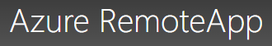



What Are Some Virtualization Service Offerings Out There?
AWS
RDS
Auto
Lessons
Cloud
Buy It
AWS Workspaces
Azure RemoteApp
Citrix Workspace Cloud
Ericom Desktop DaaS
Vmware Horizon DaaS

Slide 7
Do It Yourself
AWS
RDS
Auto
Lessons
Cloud
Deeper visibility into infrastructure for certifications
Manage the performance
Custom DaaS or App-as-a-Service offering
Use advanced technology – Ericom, Citrix, etc.

Slide 8
How Ericom Uses the Cloud
AWS
RDS
Auto
Lessons
Cloud
Focus on creating great software and let others manage the maintenance, updates, backups, etc. of the infrastructure
DevOps – running development workloads
PoCs/Demos for customers and partners
Technical Support can reproduce issues
Our Own DaaS Service for customers

Slide 9
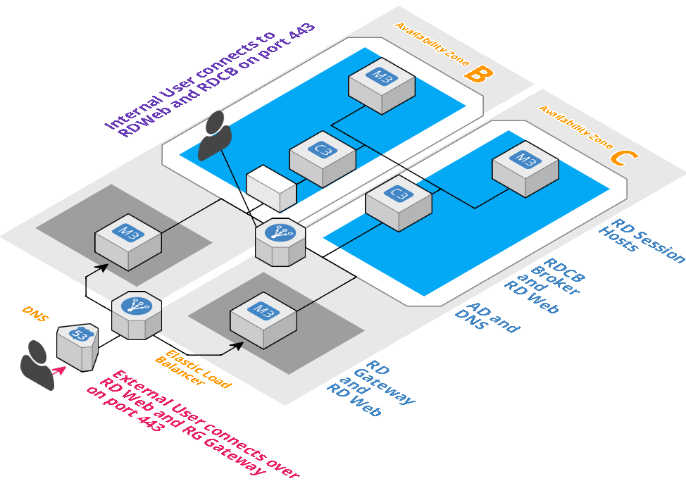
Let’s See What We Plan to Build
AWS
RDS
Auto
Lessons
Cloud

Slide 10
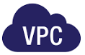
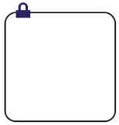


Some Definitions
AWS
RDS
Auto
Lessons
Cloud
Virtual Private Cloud (VPC): A logically isolated virtual network in the AWS cloud. You define a VPC’s IP address space from a range you select.
Subnet: A segment of a VPC’s IP address range where you can place groups of isolated resources.
EC2 Instance: these machines comprise varying combinations of CPU, memory, storage, and networking capacity . https://aws.amazon.com/ec2/instance-types/
Internet Gateway: The Amazon VPC side of a connection to the public Internet.
Security Group: virtual firewall for your instance to control inbound and outbound traffic. Each instance can have up to five security groups.

Slide 11
Build the VPC
AWS
RDS
Auto
Lessons
Cloud
Complete control over your virtual networking environment, including selection of your own IP address range, creation of subnets, and configuration of route tables and network gateways.
Create a public-facing subnet for your Secure Gateways that has access to the Internet, and place your backend systems such as connection brokers, databases, and application servers in a private-facing subnet with no Internet access.
Leverage multiple layers of security, including security groups and network access control lists, to help control access in each subnet.
https://aws.amazon.com/vpc/faqs/

Slide 12

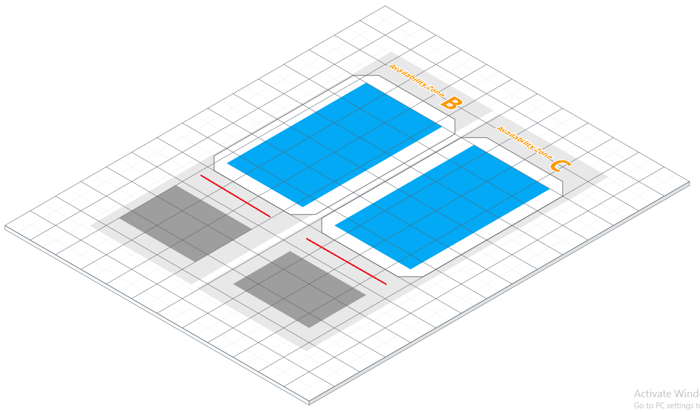
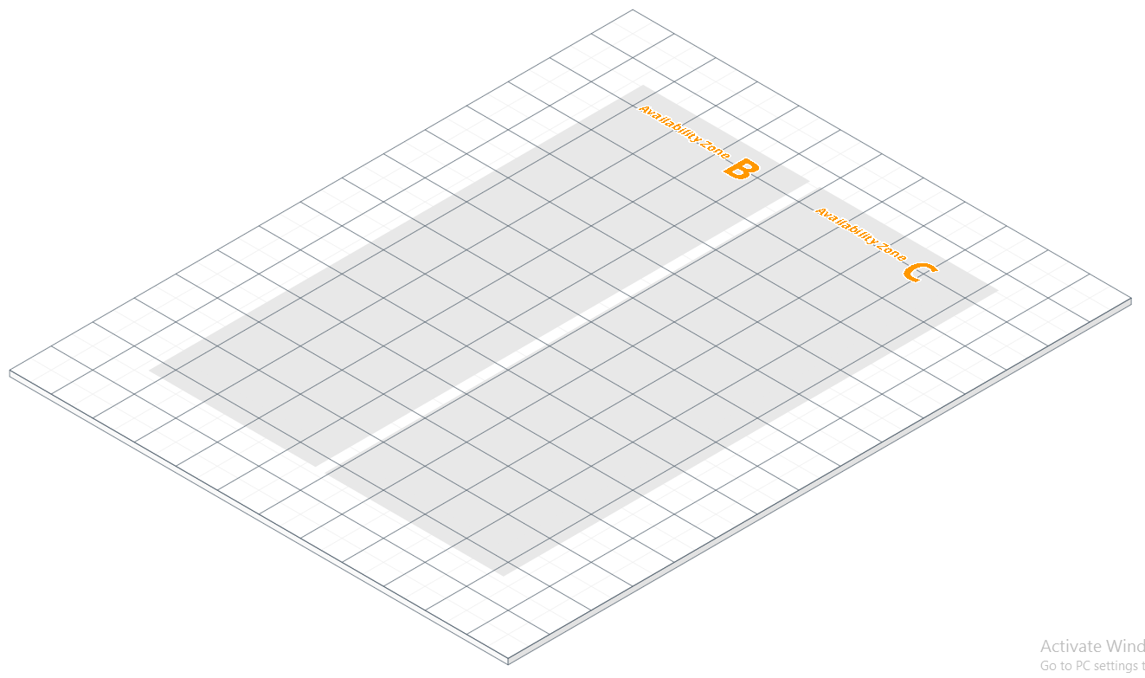
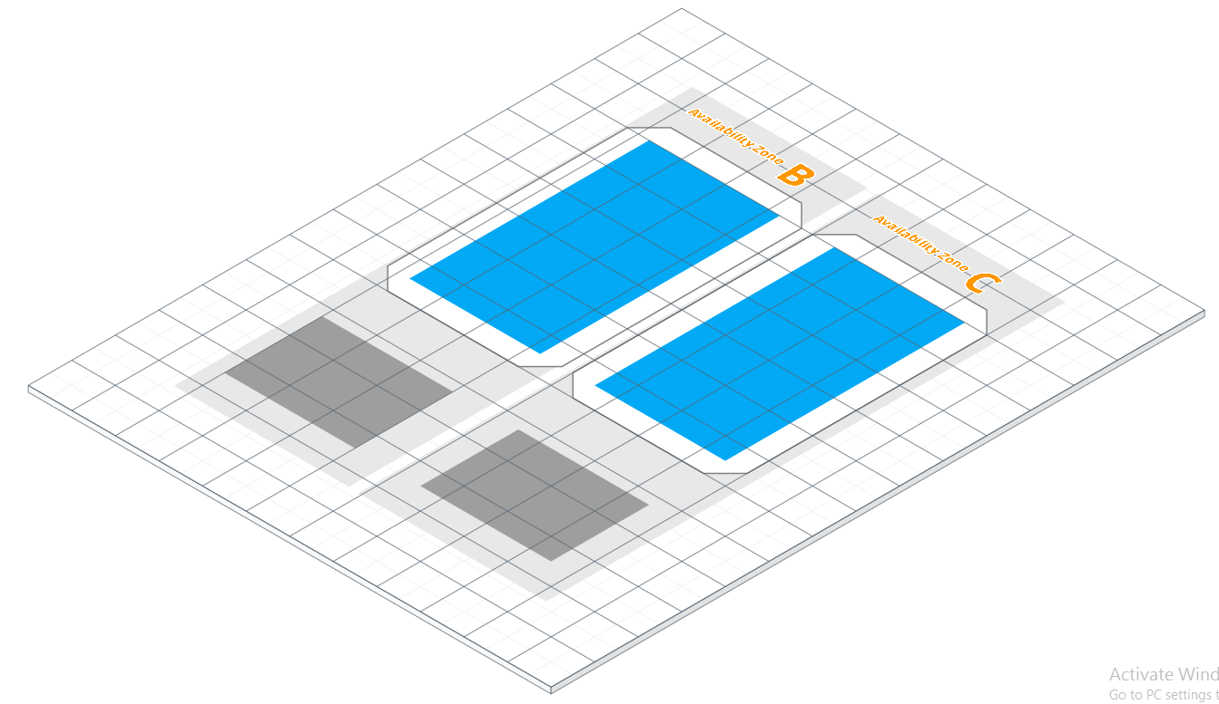

AWS
RDS
Auto
Lessons
Cloud
Each region will always have at least two Availability Zones
A VPC can span over multiple Availability Zones
Availability Zone (AZ) represent individual datacenters
Set up route tables for proper communication between subnets
Spread workload across at least two AZ’s for high availability
Each AZ in a region are separated by a low latency network
Use Network Access Control for security between subnets
Use Security Groups to secure ports at instances
Use Subnets within each AZ as needed

Slide 13
Subnetting within an AZ
AWS
RDS
Auto
Lessons
Cloud
Within each AZ, allocate a public subnet, a private subnet and some spare capacity.
Your publicly-accessible hosts will be far fewer in number than your internal-only ones, so give the public subnets half the space of the private ones.

Slide 14
Configure Routing
AWS
RDS
Auto
Lessons
Cloud
All hosts within a VPC can route to all other hosts within a VPC by default
Need at least a IGW or VPN to access the VPC
Configure which packets can route into and out of the VPC.
To provide Internet access for the Public subnet, set in the Routing Table:
10.0.0.0/16 - Local
0.0.0.0/0 - Internet Gateway
Private subnets only route internally, but you can add a NAT for Internet access:
10.0.0.0/16 - Local
0.0.0.0/0 – NAT instance

Slide 15
Internet Access (NAT vs IGW)
AWS
RDS
Auto
Lessons
Cloud
EC2 instances in a private VPC subnet need to connect to the Internet. Because the subnet is private, the IP addresses assigned to the instances cannot be used in public.
It is necessary to use Network Address Translation (NAT) to map the private IP addresses to a public address on the way out, and then map the public IP address to the private address on the return trip. There are two AWS options:
NAT Instances
NAT Gateway
An Internet Gateway (IGW) provides two-way access to/from the Internet and is usually used from the public subnet. The IGW allows the public subnet to receive inbound traffic directly from the Internet, whereas the instances in the private subnet can not.

Slide 16
AWS Elastic Load Balancing
AWS
RDS
Auto
Lessons
Cloud
Use the EC2 Admin Console to create an ELB to balance load between the gateways
Load Balancers -> Create Load Balancer
Enter a name for the ELB and Configure Health Check
Set the Ping protocol: HTTPS, port 443
Assign Security Group
Create group: TCP 443
Add Listeners
Add Instances
Set ELB to point to the gateway machines

Slide 17
Name that Load Balancer
AWS
RDS
Auto
Lessons
Cloud
Must assign a Domain Name as a Cname to the ELB address
ELB Address that can be used for testing: https://ec-1612090963.us-west-2.elb.amazonaws.com/RDWeb/Pages/en-US/login.aspx
Cname association in your provider

Slide 18
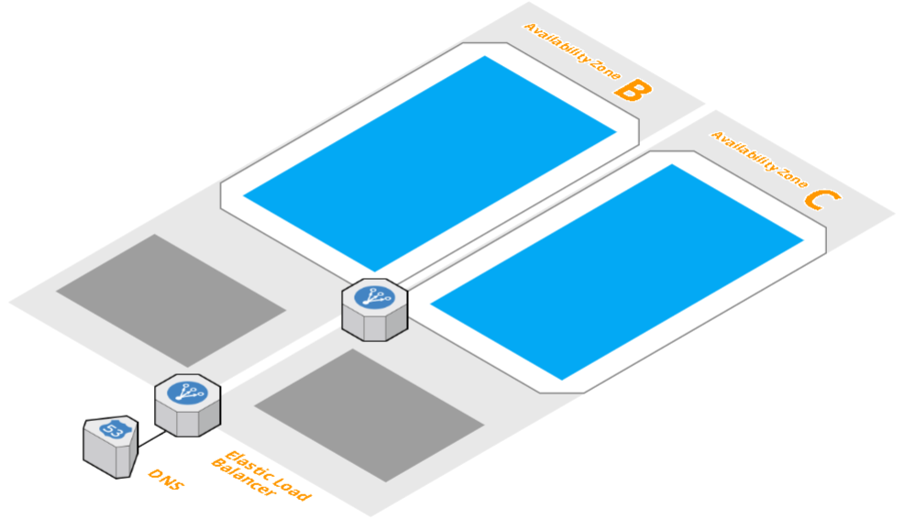
AWS Part Complete
AWS
RDS
Auto
Lessons
Cloud

Slide 19
RDS Pre-Requisites
AWS
RDS
Auto
Lessons
Cloud
Active Directory
Administrator Access
Trusted SSL Certificate
Public IP address
SQL (for HA)
Load Balancer (for HA)

Slide 20
Refresher
AWS
RDS
Auto
Lessons
Cloud
Remote Desktop Connection Broker
RD Gateway (RDGW)
Session Hosts (RDSH)
RD Web Access (RDWA)
License Server
Remote Desktop Virt Host

Slide 21
Where do they go
AWS
RDS
Auto
Lessons
Cloud
RDSH
private subnet
RDCB
private subnet
License Server
private subnet
RDGW
public subnets
RDWeb
public and private subnets

Slide 22
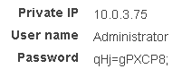
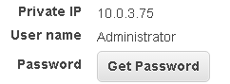
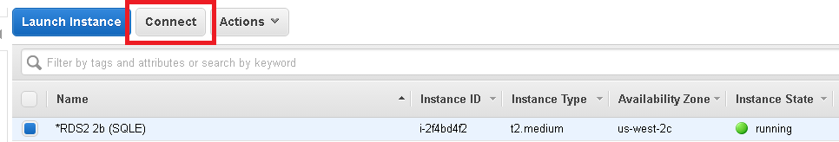
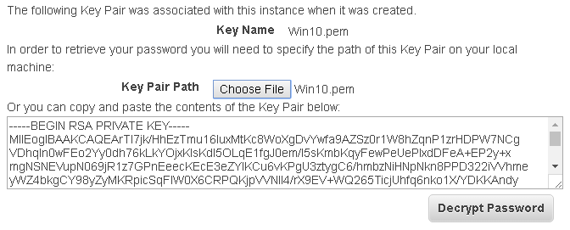
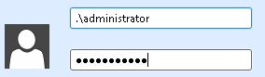
Get the password
AWS
RDS
Auto
Lessons
Cloud
Need a PEM file – create in AWS
Click Connect on the instance, even if not publicly accessible
Click Get Password
Select the PEM file and click Decrypt
Copy Paste the password and change it in Windows if desired

Slide 23
RDGW – Join that Domain
AWS
RDS
Auto
Lessons
Cloud
RD Gateway server has to be domain-joined because it has to authenticate and authorize corporate domain users and resources.
“No AD DS in perimeter network: There is no AD in the perimeter network and RD Gateway (in the perimeter network) is joined to the internal domain.
Forest trust model: One-way trust between the perimeter network AD DS and the internal network AD DS. RD Gateway is joined to perimeter AD DS.
Extended corporate forest model: A read-only domain controller for the internal network forest is in the perimeter network, and RD Gateway is joined to the internal network domain.”
https://blogs.technet.microsoft.com/enterprisemobility/2009/07/31/rd-gateway-deployment-in-a-perimeter-network-firewall-rules/

Slide 24
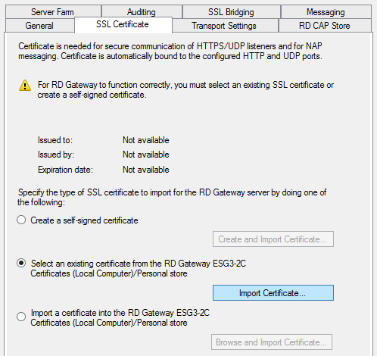
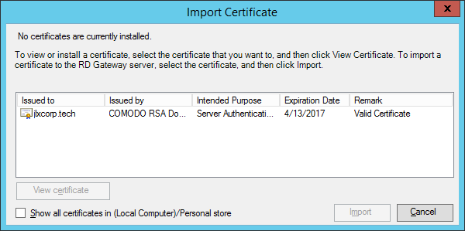
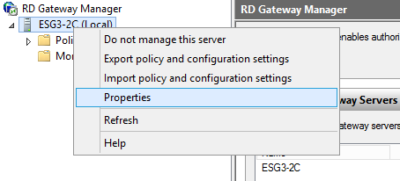
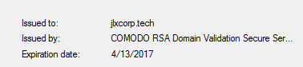
Config SSL Certificate in RDGW
AWS
RDS
Auto
Lessons
Cloud
Open the RDGW Manager
Select the server and go to Properties
Go to SSL Certificate
Select the Certificate and click Import

Slide 25
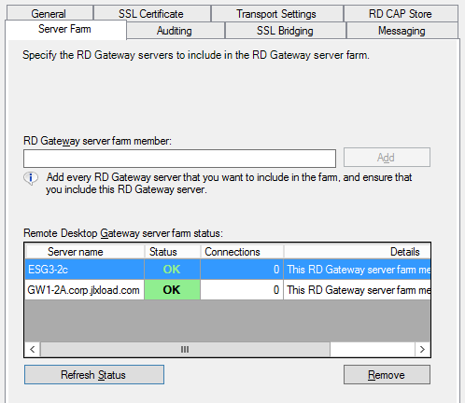
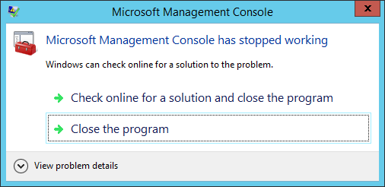
RD Gateway permissions
AWS
RDS
Auto
Lessons
Cloud
Have to install and configure certificate on servers manually
Set RD Farm properties manually

Slide 26
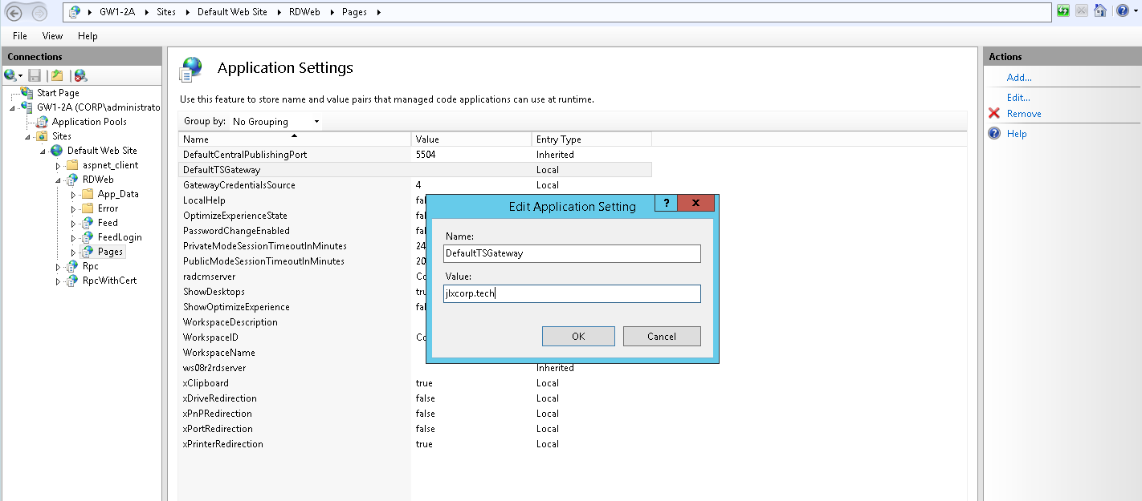
Set Default Gateway in IIS
AWS
RDS
Auto
Lessons
Cloud

Slide 27
RDGW – Set up a farm
AWS
RDS
Auto
Lessons
Cloud
“A client connection to RD Gateway is actually comprised of two connections. In the RPC over HTTP Remote Desktop Gateway scenario, if those two connections get split onto two different RD Gateway servers, the second RD Gateway server will route the data to the first RD Gateway server using RPC, if they are members of the same farm”

Slide 28
RDGW Load Balancing
AWS
RDS
Auto
Lessons
Cloud
DNS RR cannot tell when an RD Gateway farm member goes offline. It will continue to route connection requests to the offline server even though the server cannot fulfill them.
Use “smarter” load balancing technology, like AWS Elastic Load Balancer

Slide 29
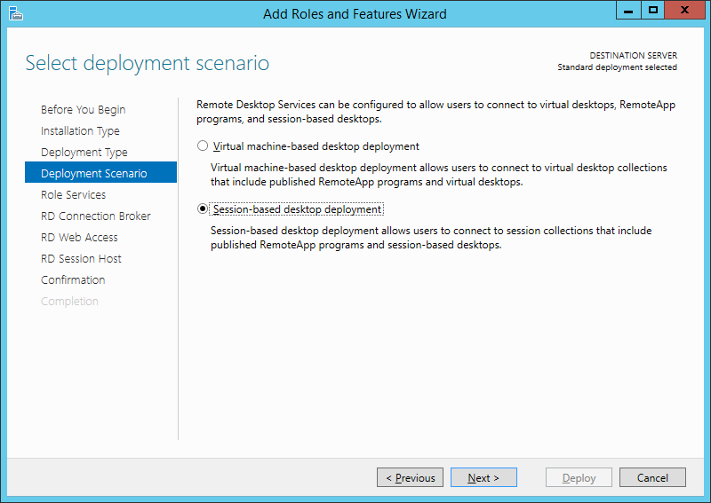
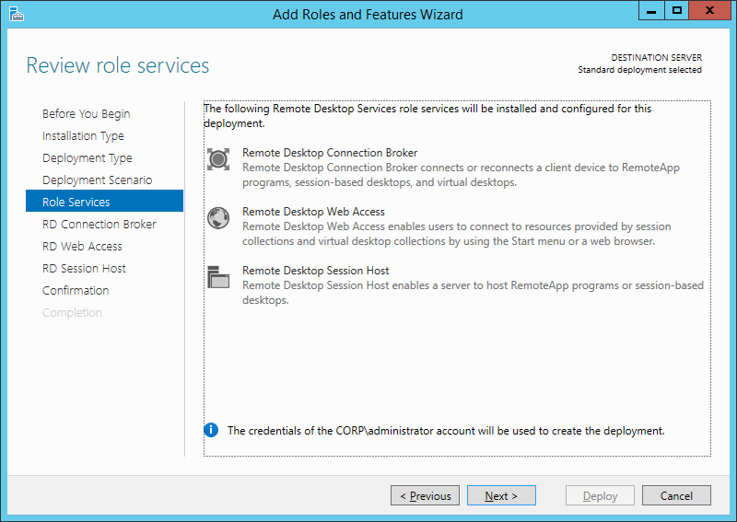
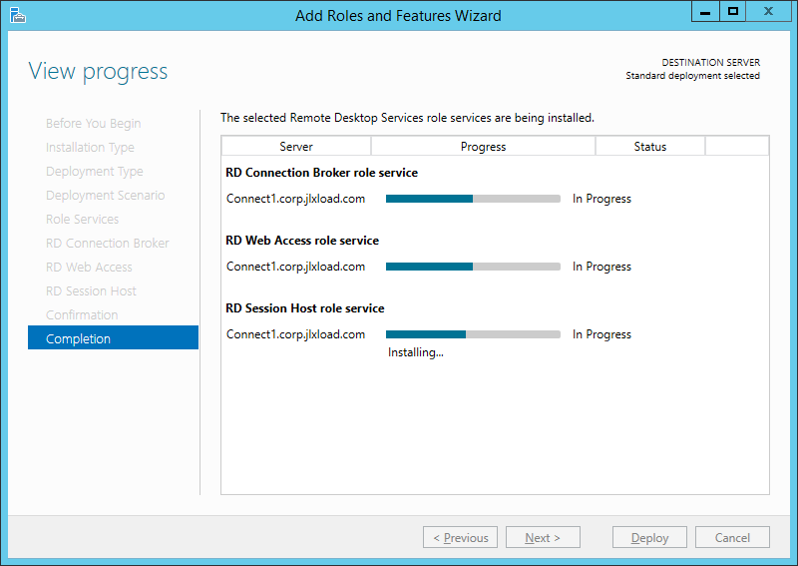
RDCB Configuration
AWS
RDS
Auto
Lessons
Cloud
Create a Session-based Deployment
Notes:
RDCB Configuration

Slide 30
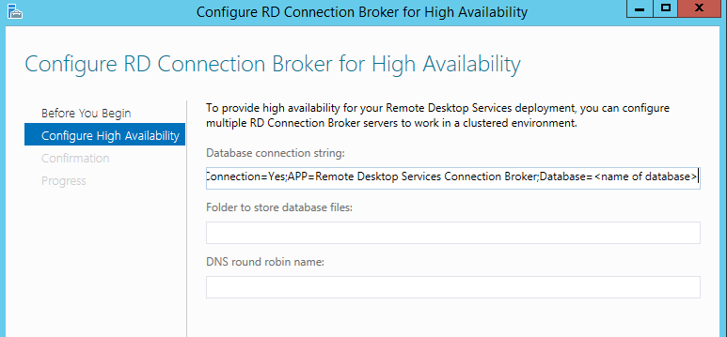
RDCB High Availability
AWS
RDS
Auto
Lessons
Cloud
https://technet.microsoft.com/en-us/library/cc772506(v=ws.11).aspx
Notes:
ecwest.cdrcmiuvjqgs.us-west-2.rds.amazonaws.com:1433
http://microsoftplatform.blogspot.com/2012/04/how-to-configure-high-availability-for.html
DRIVER=SQL Server Native Client 10.0;SERVER=ecwest.cdrcmiuvjqgs.us-west-2.rds.amazonaws.com;Trusted_Connection=Yes;APP=Remote Desktop Services Connection Broker;Database=EricomConnectAWS
Is DNS RR good enough?
Cannot support AWS cloud database as RDCB requires windows authentication to SQL server

Slide 31
RDSH Session Host AMI Image
AWS
RDS
Auto
Lessons
Cloud
Do not use the Windows Sysprep command. Use the EC2ConfigService Settings.
Configure the Sysprep parameters and the Administrator password using this tool. Click “Shutdown with Sysprep” to begin the Sysprep operation.
The procedure above does not join new instance to the Domain. There are methods to do this in the AWS XML answer file (e.g. UnattendedJoin)
Notes:
For more information visit this AWS website: http://docs.aws.amazon.com/AWSEC2/latest/WindowsGuide/ami-create-standard.html#sysprep-gui-procedure

Slide 32
…Final Deployment
AWS
RDS
Auto
Lessons
Cloud

Slide 33
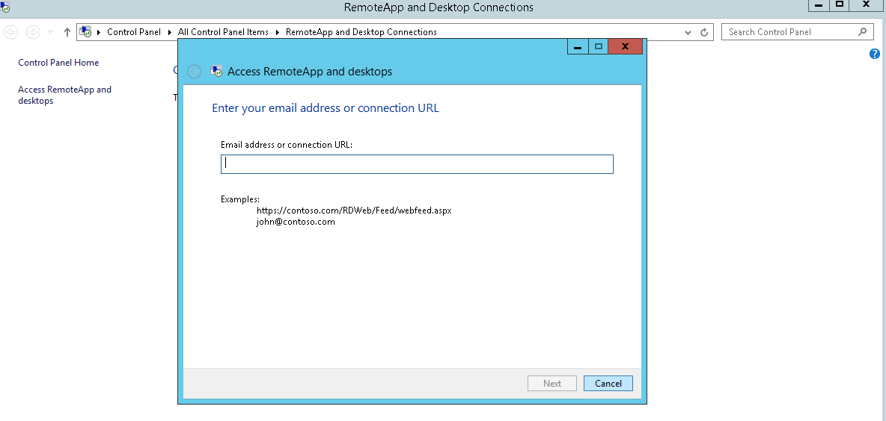
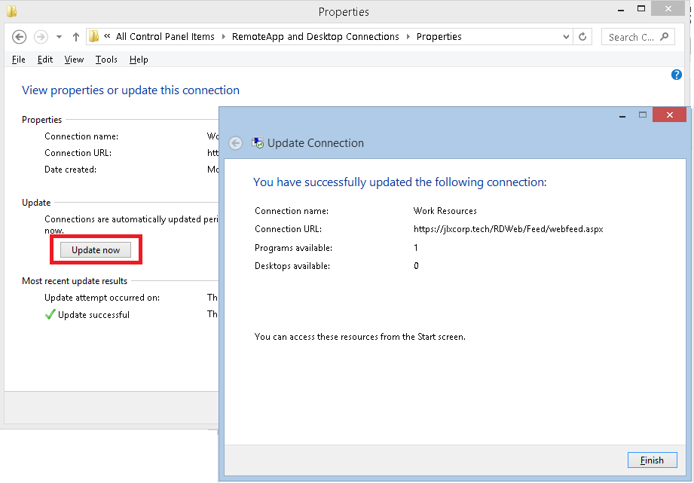
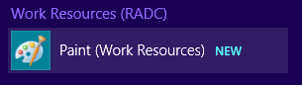
End-User Access
AWS
RDS
Auto
Lessons
Cloud
RDWeb
.rdp file
RDCB WebFeed
Enter the feed address
Updating apps require pressing the button
User access via ..\Programs\Work Resources (RADC)

Slide 34
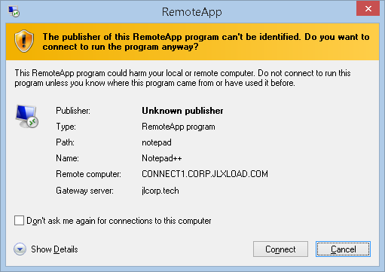
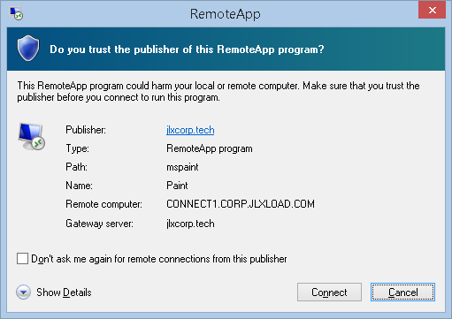
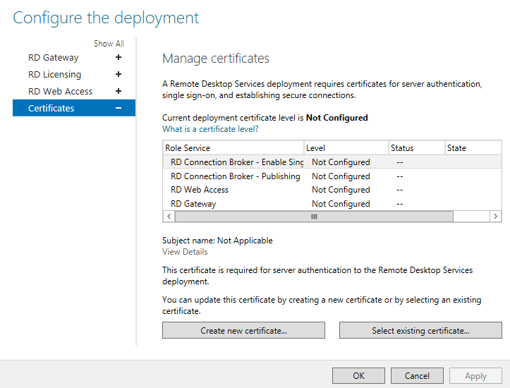
Install SSL Certs
AWS
RDS
Auto
Lessons
Cloud
To resolve the “Unknown Publisher” message, a trusted certificate needs to be installed on all the components.
Use Server Manager to do this.
Notes:
Add Cert Removes unknown publisher
EC does not have to deal with this

Slide 35
Why automate
AWS
RDS
Auto
Lessons
Cloud
Do you want to deploy your system as you seen in this demo ?
Do you remember all the small details that needs to be done ?
Can you be sure to deploy the same environment every time

Slide 36

Use Case Benefits
AWS
RDS
Auto
Lessons
Cloud
Service provider wants to onboard a new customer environment. An automation script will do this to exact specifications
IT Engineer can deploy new user assignments, system resources, and software configuration with a push of a button.
CFO is happier because automation can power down VM’s in the cloud to save on hourly expense or hibernate VM’s to save on electricity expense in the datacenter
Notes:
EP

Slide 37
Automation Tools
AWS
RDS
Auto
Lessons
Cloud
Let’s focus on
PowerShell DSC and PowerShell

Slide 38
PowerShell
AWS
RDS
Auto
Lessons
Cloud
Task automation framework from Microsoft
PowerShell give you the power of .NET with the flexibility of scripting
PowerShell can perform tasks on both local and remote Windows systems
Notes:
EP

Slide 39
PowerShell Example
AWS
RDS
Auto
Lessons
Cloud

Slide 40
PowerShell DSC
AWS
RDS
Auto
Lessons
Cloud
Looks like PowerShell
Admin create blueprints, describing what is the desired system state
Extensive support for Windows configurations with prebuilt modules like xActiveDirectory, xDhcpServer , xRemoteDesktopSessionHost + more
Support a central configuration server

Slide 41
PowerShell DSC example
AWS
RDS
Auto
Lessons
Cloud

Slide 42
PowerShell DSC vs PowerShell
AWS
RDS
Auto
Lessons
Cloud
WindowsFeature Remote-Desktop-Services
{
Ensure = "Present"
Name = "Remote-Desktop-Services"
}
xRDSessionCollection Collection
{
CollectionName = $collectionName
CollectionDescription = $collectionDescription
SessionHost = $localhost
ConnectionBroker = $ConnectionBroker
}
Install-WindowsFeature Remote-Desktop-Services
New-RDSessionCollection –CollectionName $CollectionName –SessionHost $localhost –CollectionDescription “This Collection is for Desktop Sessions” –ConnectionBroker $ConnectionBroker

Slide 43
What Can be Automated
AWS
RDS
Auto
Lessons
Cloud
AWS Architecture
Windows configuration
System Deployment
User Provisioning
Application Installation
Health Monitoring and Alerting

Slide 44
PowerShell Spotlight: Monitoring
AWS
RDS
Auto
Lessons
Cloud
Sample PowerShell script to monitor the system’s health
Update windows event log for monitoring tools
Send an email to the Admin when needed
Link – Monitor Script
Notes:
EP

Slide 45
PowerShell Spotlight: Publishing
AWS
RDS
Auto
Lessons
Cloud
Sample PowerShell script to install applications using Choclotey
Publish the installed apps to the RDCB Collection
Link – Install and Publish Script
Notes:
EP

Slide 46
PowerShell Spotlight: Deployment
AWS
RDS
Auto
Lessons
Cloud
PowerShell script to build an Session Host
Windows configurations and checkup
Add the Host to the Connection broker
Install applications and publish them
Updating windows event log for status, allowing 3rd party monitoring tools to monitor the system
Sends a mail with info on severe errors
Link - PowerShell script
Notes:
EP

Slide 47
PS DSC Spotlight: Deployment
AWS
RDS
Auto
Lessons
Cloud
Build a deployment using PowerShell DSC
Link - DSC configuration
Notes:
EP

Slide 48
Spotlight: Manage AWS w/ PS
AWS
RDS
Auto
Lessons
Cloud
PowerShell Script to launch and remotely connect to an EC2 Instance
Launch an instance
Set the firewall rules
Create key pairs
Enables PS remoting
Connect to the instance remotely and finally terminate it
Link – PowerShell Script to launch and remotely connect to an EC2 Instance
Notes:
EP

Slide 49
Chocolatey
Windows Package Manager
Simple tool to deploy applications
More then 4000 Applications
Easy to use
choco install office365homepremium
choco upgrade notepadplusplus
Link - Chocolatey

Slide 50
Lessons Learned (Cloud)
AWS
RDS
Auto
Lessons
Cloud
The cloud provides a agile and elastic platform to run RDCB workloads
Be aware that configuration of subnets, security, and other cloud components may be different, but feel familiar
Automation can make your life happy

Slide 51
Lessons Learned (RDCB)
AWS
RDS
Auto
Lessons
Cloud
RDCB configuration can be very tedious
Many admin consoles…
RDCB has limitations for Enterprises
Missing Multi-tenancy, Delegate Admin, Analytics, sophisticated RDSH Load Balancing
Each component has to be made highly available individually – more tedious work
These limitations can be overcome with a more advanced solution like Ericom Connect or Citrix XenApp

Slide 52





Thank You + More…
AWS
RDS
Auto
Lessons
Cloud
Git Repo
https://github.com/EricomSoftwareLtd/BriForum2016
Erez
http://www.linkedin.com/in/erezpasternak
James
http://www.linkedin.com/in/james-lui-3038324
Ericom
http://www.linkedin.com/company/ericom-software
@Ericom_Software

Slide 53
Credits
AWS
RDS
Auto
Lessons
Cloud
AWS Website
Microsoft Website
Google Search
RDS Architecture
https://blogs.technet.microsoft.com/yungchou/2010/01/04/remote-desktop-services-rds-architecture-explained/
RDS Gateway Config in IIS
http://www.concurrency.com/blog/w/remote-desktop-can%E2%80%99t-find-the-computer-through-rdw

Slide 54
Ericom Connect Value Proposition over RDS
Custom Delegated Admin Roles – define your own admin roles based on organization hierarchy
Multi-tenancy – built-in multi-tenancy feature for security and service provider use cases
Simple grid management – easily connect Terminal Servers and Desktops from different geographical regions into one easy to manage environment
Mixed Mode OS support – onboard any Windows OS into the grid
AccessNow HTML5 functionality for access from any device
AccessToGo mobility features – PPI resolution, full keyboard, mouse options …
Add Linux workloads

Slide 55
More Value Proposition over RDS
Built-in reports for application usage, user auditing, system information, etc.
Built-in analytics for data visualization and ad-hoc analysis
High availability load balancing based on dynamic allocation, not sequential rankings or DNS round-robin
Ease-of-use: Installing a fully functional RDCB/RDS virtualization solution is a tedious task. It takes several hours to install various server roles, applications and components such as connection broker and Network Load Balancing. Ericom Connect takes a few minutes to install and onboard session hosts of all types

Slide 56
Ericom Connect Runs on AWS
Compatible with AWS RDS Microsoft SQL
Compatible with AWS Microsoft AD and Simple AD
ESG is compatible with Auto scaling
RDSH Terminal Server is compatible with Auto scaling
Ericom Connect is compatible with all EC2 features

Slide 57
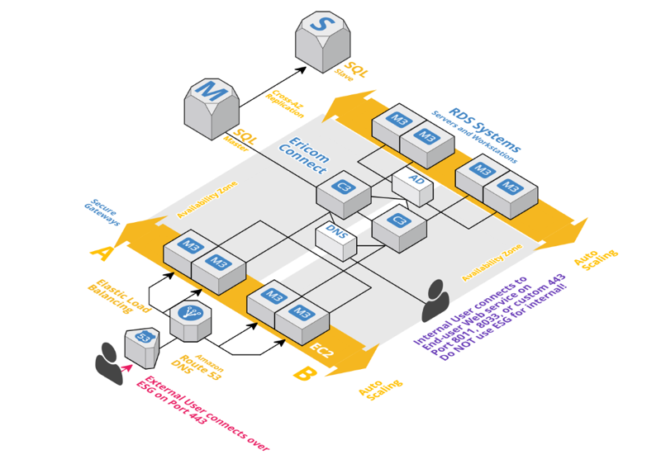
Works with AWS Auto-Scaling

Slide 58
Manual Configuration
Add configuration one at a time, make sure all components work before adding second servers for high availability
RD Web
RD Gateway
RDCB
Licensing Server

Slide 59
Enabling RDSH SSO
Typically, people implement SSO on intranets, but you can also use it with RD Gateway.
To make SSO work on your intranet, you must meet the following conditions:
Your clients must be domain joined and able to receive GPO policies.
Set the Security Layer on the RDP connection to either Negotiate or SSL (TLS 1.0), and encryption to either High or FIPS.
The following Computer GPO must be applied to client computers: Computer Configuration / Policies / Administrative Templates / System / Credentials Delegation / Allow Delegating Default Credentials. Add your RDS servers to this list as TERMSRV/<server-name-here>. You may use wildcards to include many servers for example:
TERMSRV/*.rdsgurus.com
Note: Don’t use TERMSRV/* – this is a security risk as it means: ALL servers running terminal services.
If you want to use RD Gateway with SSO, apply the following User GPO to your users:
User Configuration / Policies / Administrative Templates / Windows Components / Remote Desktop Services / RD Gateway / Set RD Gateway Authentication Method
Choose: Use Locally Logged-On Credentials
Side note: This GPO has a checkbox option for “Allow users to change this setting”. If you check this box, then if the following RDP file setting is present in the RDP file, it must be set to 0: gatewayprofileusagemethod
Here’s why: If SSO GPOs are not set (for example, a non-domain joined PC) then if the value of this setting is set to 1, it allows the RD Gateway value to be used in an RDP connection. If it is set to 0, then the RD Gateway value disappears. But, if it is present when trying to achieve SSO and its set to 1, SSO will fail for users where the GPO applies.
(If you do not check the box for allow users to change this setting, then this setting is ignored if it is included in the RDP file settings).
If for some reason you are sending all connections through RD Gateway (both internal and external connections) then clients connecting from inside the corporate network will use Kerberos to verify the authenticity of the RD Connection Broker. But to achieve SSO from outside your corporate network, you can’t use Kerberos for server authentication – instead you will check the RD Connection Broker’s SSL certificate. See the “Deploying SSL Certificates” section to add the appropriate SSL certificate to the deployment.
Notes:
http://www.rdsgurus.com/ssl-certificates/windows-2012-r2-how-to-create-a-mostly-seamless-logon-experience-for-your-remote-desktop-services-environment/
In Windows Server 2012 R2, RD Connection Broker receives all incoming connection requests and determines what session host server will host the connection. So, when an RDP 8 client tries to verify the identity of the server it is connecting to, it is really verifying the identity of the RD Connection Broker.
When thinking about how you’re going to set up the certificates on RD Connection Broker, consider the following:
For Single Sign-On, RD Connection Broker identifies itself by its “Client Access Name”.
The Client Access Name must be listed on the installed SSL certificate (or be covered by a wildcard certificate).
The broker’s client access name must be resolvable in DNS that RD Connection Broker uses.
Here is where things get a little tricky. You know the name on the certificate must match the name RD Connection Broker uses to identify itself. If you make your RD Connection Broker highly available, you set the client access name yourself, so you can choose a name that is listed on your certificate and resolvable in your company DNS. But if you have only one RD Connection Broker, by default the client access name is set as the computer name of the server and there is no obvious way to change it.
How much this matters depends on the domain suffix of your internal domain. You can no longer get certificates for private domain suffixes from public CAs, so companies that use a private (e.g. .local) suffix for their internal domain have a dilemma: how to make the certificate name match the client access name, which also has to resolve in your corporate internal DNS. I will explain how to reconcile a server name with a private suffix with the need to map the Client Access Name to the certificate in the “Connecting Through RD Gateway – Private Domain Suffix” section. For now, just remember that this is something you’ll need to be careful of.

Slide 60
Firewall consideration
Your RD Web Access server needs to communicate with your RDSH server using RPC to retrieve the list of RemoteApps. Your RDWeb server's computer account needs to be a member of the local TS Web Access Computers group on your RDSH server.
Notes:
3. Your RD Web Access server needs to communicate with your RDSH server using RPC to retrieve the list of RemoteApps. Your RDWeb server's computer account needs to be a member of the local TS Web Access Computers group on your RDSH server.

